Slide 1

CSAT - Detailed Business Analysis
Report
PRESENTED BY
SATHYANARRAYANAN
(sathyanarrayanan@gmail.com)

Slide 2

OBJECTIVE
The objective of this analysis is to evaluate customer support performance and identify key factors impacting customer satisfaction using data extracted from the SQL database.
This study aims to:
Analyze key operational metrics such as call volume, call duration, SLA performance, and CSAT scores
Identify major drivers of customer dissatisfaction, particularly focusing on call reasons and service inefficiencies
Understand customer behavior across different channels and geographic regions
Detect trends in call volume to assess future operational demand
Based on these insights, the analysis aims to provide data-driven business recommendations
to improve customer experience, optimize operational efficiency, and reduce support costs.

Slide 3
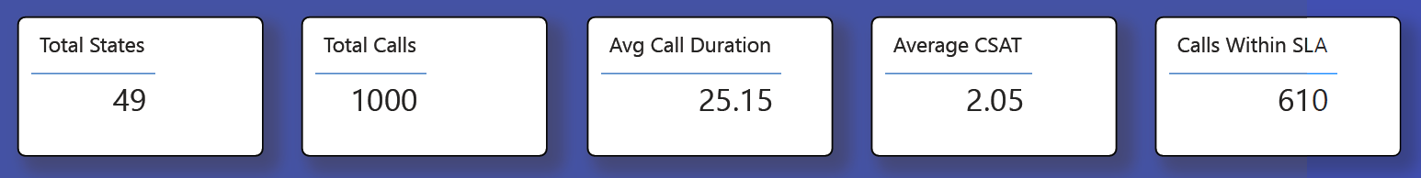
KPI INSIGHT
The dashboard highlights a concerning gap between operational performance and customer satisfaction. While the total call volume of 1000 indicates a stable but active customer base, the average call duration of 25.15 minutes is significantly high, suggesting that customers are facing complex issues or agents are struggling to resolve queries efficiently.
The most critical concern is the average CSAT score of 2.05 out of 5, which clearly indicates widespread customer dissatisfaction. This low score reflects poor service experience, delayed resolutions, or lack of clarity in communication.
Although 61% of calls are handled within SLA, this level of compliance is not sufficient to ensure a high-quality experience. The combination of long call durations and low satisfaction suggests that even when SLAs are met, the quality of resolution is not meeting customer expectations.
Business Interpretation:
Operational metrics may appear acceptable at a surface level, but customer experience is failing. This indicates a quality issue rather than just a performance issue.

Slide 4
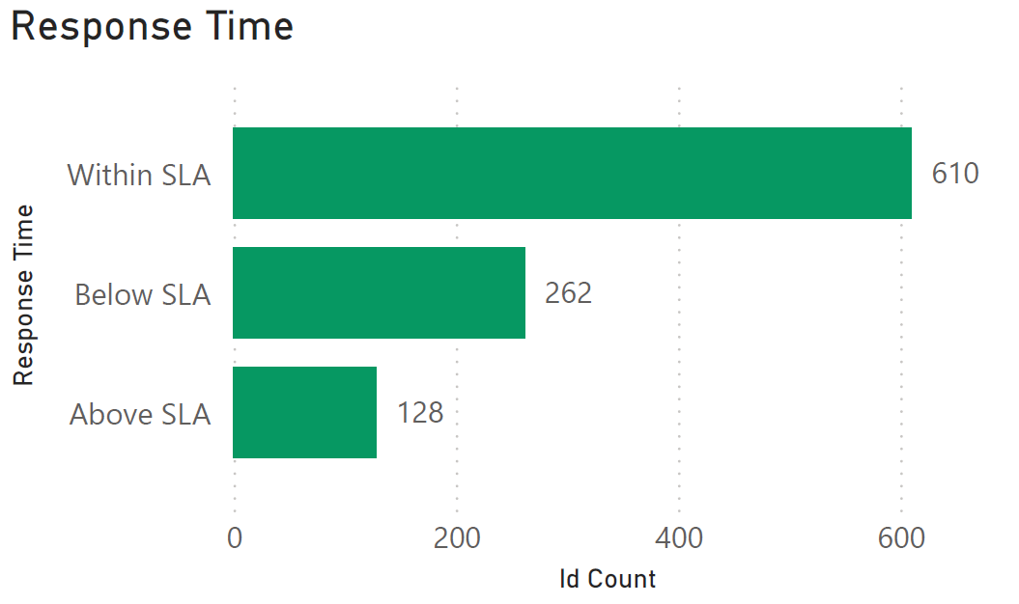
Response Time (SLA Performance)
The response time analysis shows that while a majority of calls fall within SLA limits, a significant 39% of calls fall outside acceptable performance thresholds. This inconsistency creates an unpredictable customer experience.
Customers today expect quick and reliable responses, and even a small percentage of delays can heavily impact satisfaction levels. The variation in SLA adherence suggests inefficiencies in workload distribution, agent availability, or prioritization mechanisms.
Business Interpretation:
SLA compliance alone is not enough - consistency is key. The current variation is likely contributing directly to the low CSAT score.

Slide 5
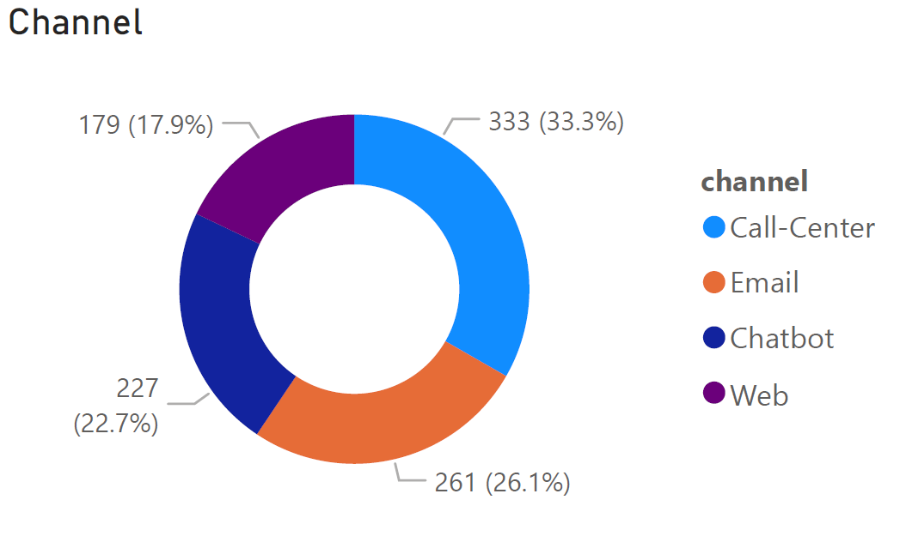
Channel Distribution Analysis
The data shows that the Call Center is the dominant channel (~33%), indicating strong reliance on human support. Email and chatbot channels contribute moderately, while the web channel remains underutilized.
This suggests that customers either:
Do not trust automated/self-service channels, or
Are not getting effective resolutions through them
Business Interpretation:
High dependency on call centers increases operational cost and pressure. It also indicates a gap in digital experience and automation maturity.

Slide 6
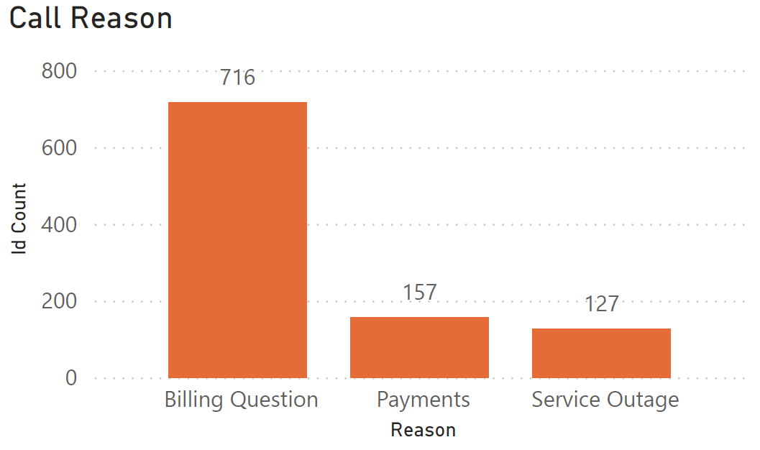
Call Reason Analysis
Billing-related queries account for nearly 70% of total calls, making it the primary driver of customer interactions. Other categories like payments and service outages are significantly lower.
This clearly indicates that customers are facing:
Confusion in billing statements
Lack of transparency
Possible billing errors
Business Interpretation:
Billing is not just a support issue - it is a core business process failure impacting customer trust and experience.

Slide 7
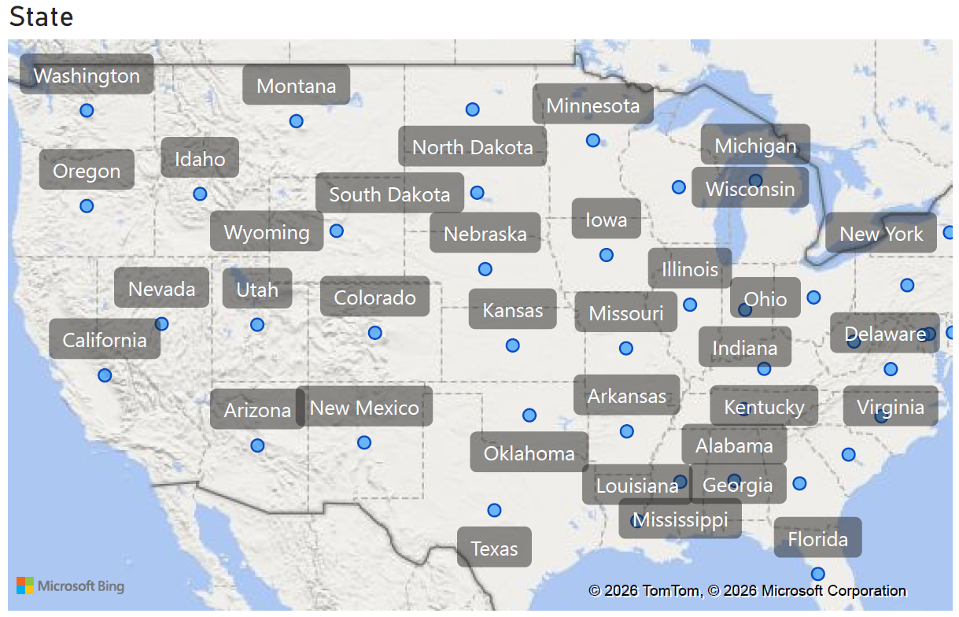
Geographic Distribution Analysis
The call distribution is relatively even across different states, indicating that the issues are not region-specific.
This eliminates external factors like regional service quality or infrastructure and points toward centralized operational or process issues, especially in billing and support systems.
Business Interpretation:
The problem is systemic, meaning improvements must
be implemented at the organizational level, not locally.

Slide 8
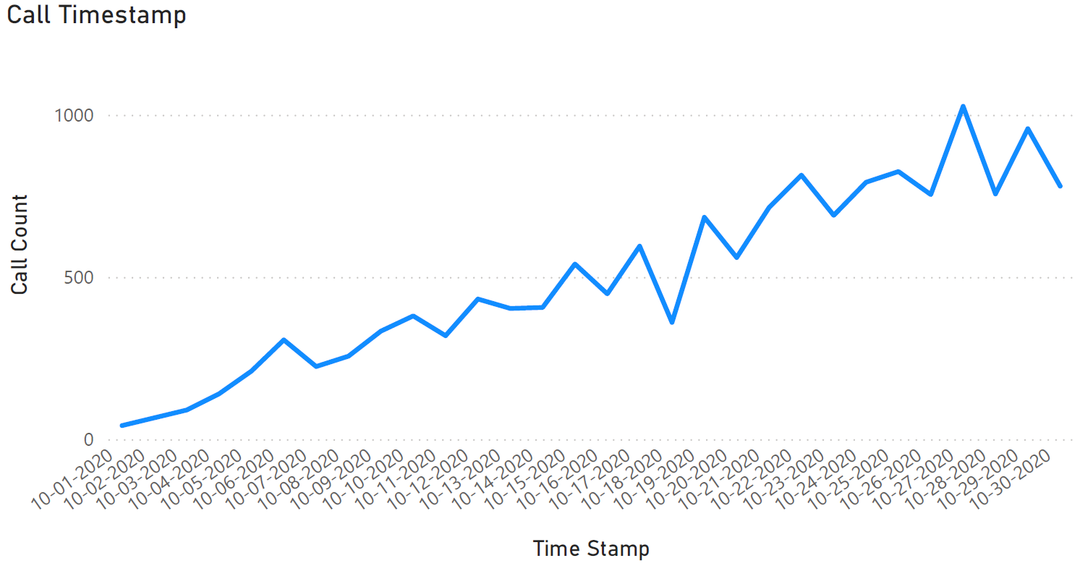
Call Volume Trend Analysis
The upward trend in call volume indicates increasing demand on customer support services. The noticeable peak towards the later period suggests either:
Growth in customer base, or
Rising number of unresolved issues
If the increase is driven by complaints (especially billing), it signals worsening service quality.
Business Interpretation:
If not addressed, this trend will lead to:
Higher operational costs
Increased agent workload
Further drop in customer satisfaction

Slide 9
BUSINESS RECOMMENDATIONS
1. Billing System Optimization
Billing issues being the major driver (70%) require immediate attention.
Redesign billing statements with clear, itemized breakdowns
Introduce real-time billing dashboards for customers
Send proactive notifications explaining charges before billing cycle
Implement billing dispute resolution workflows
Impact: Reduces call volume significantly and improves transparency
2. Customer Experience Enhancement
Improving CSAT requires both process and people improvement.
Conduct agent training programs focused on communication & empathy
Introduce quality monitoring systems for calls
Capture and analyze customer feedback data regularly
Implement First Call Resolution (FCR) tracking
Impact: Direct improvement in CSAT score
3. Reduce Call Duration (Operational Efficiency)
Long call duration indicates inefficiency.
Build a centralized knowledge base for agents
Standardize responses for common queries (especially billing)
Automate repetitive backend tasks
Introduce call scripts for faster resolution
Impact: Faster resolution → reduced cost → improved experience

Slide 10
BUSINESS RECOMMENDATIONS
4. Digital Transformation (Automation & Self-Service)
Reduce dependency on call centers.
Upgrade chatbot with AI-based resolution capability
Add self-service options for billing, payments, and FAQs
Improve website/app usability for quick issue resolution
Impact: Lower operational cost + scalable support system
5. Improve SLA Performance
Consistency is more important than just achieving SLA targets.
Optimize workforce planning and shift allocation
Introduce priority-based ticket handling
Monitor SLA breaches in real-time dashboards
Impact: More consistent experience → higher customer trust
6. Future Demand Planning & Scalability
Call volume is increasing and needs proactive planning.
Use trend forecasting models to predict call volumes
Increase staffing during peak periods
Scale infrastructure and support systems accordingly
Impact: Prevents service breakdown and maintains quality during growth

Slide 11
BUSINESS RECOMMENDATIONS
The analysis clearly indicates that customer dissatisfaction is primarily driven by billing issues, inefficient resolution processes, and inconsistent service performance.
While operational metrics show moderate performance, the customer experience is significantly impacted, highlighting a gap between execution and expectation.
Addressing billing transparency, improving operational efficiency, and investing in digital transformation will be critical to:
Reduce call volume
Improve CSAT
Optimize cost
Build long-term customer trust

